Slide 1


Surface Anatomy
SURFACE ANATOMY
Lumbar Spine and Sacrum

Slide 2
Why Practice Surface Anatomy?
Surface Anatomy
Reliability and Consistency with Palpation
Important for Mobility Testing with Exam
Improved PT Confidence with Differential Dx
Improved Sensory Discrimination

Slide 3
Helpful Hints
Palpate Perpendicular to the Structure
Use a Light Touch
Use Second or Third Finger
Use a Repeatable and Reliable Process

Slide 4
Bony Structures
Surface Anatomy
Iliac Crest
PSIS (S2)
Sacral Hiatus
Sacral Horns (Cornus Sacralis)
Sacral Borders
Spinous Processes of L1 to S2
Greater Trochanter
Ischial Tuberosity

Slide 5
Soft Tissue and Neural Structures
Surface Anatomy
Superior Gluteal Nerve
Piriformis Muscle
Inferior Gluteal Nerve
Sciatic Nerve

Slide 6
IV. Posterior Bony and Soft Tissue Structures
(Position patient prone)
Surface Anatomy
Begin palpating along the iliac crests from lateral and progress posterior and medial. Just outside the paraspinal muscle mass, the iliac crest takes a sharp turn downwards and widens. Continue to palpate downwards along the iliac crest until falling off a step. Turn your palpating finger cranially and push. Notice that the finger is abruptly stopped by a bony structure known as the posterior superior iliac spine (PSIS).
Take notice that the PSIS location is not in the “dimples”. The location is just caudal and lateral to the “dimples”. Find the PSIS on the other side.
Once both PSIS’s have been outlined, draw a helper’s line along the caudal edge of each PSIS connecting them. Place an “x” in the center of the line over the central sacrum. This is the location of S2.
From S2, palpate caudally along the sacral spinous processes (or medial sacral crest) until the finger no longer palpates a crest and falls off a small step. Also, the endfeel will change from hard to “leathery”. Turn the palpating finger cranially and push. If the finger does not slide cranially, the location of the sacral hiatus has been reached. This is clinically relevant since many pain procedures utilize this entrance into the spinal canal.
Palpate just laterally on both sides of the sacral hiatus. Take notice of the bones on each side. This is the location of the cornuae sacralis or sacral horns. Outline them.
Now, connect another helper’s line from the PSIS to the sacral hiatus. About 1 cm laterally from this line, the sacral border can be palpated.

Slide 7
Surface Anatomy
Divide the previous helper’s line into thirds and label “line A”.
Next, find the cranial tip of the Greater Trochanter of the femur. This can be felt at the widest part of the hip and verified by placing the finger over the area and gently IR and ER the femur. Find the most cranial point and place a colored circle at this spot.
Now, draw a helper’s line connecting the ipsilateral PSIS to the cranial tip of the greater trochanter (call this line “B”).
Connect another helper’s line from the distal 2/3 of line “A” to the greater trochanter (call this line “C”).
The triangle formed between lines B and C represents the area of the piriformis muscle.
Now, palpate the ischial tuberosity lying medially along the gluteal fold. Outline this structure and draw a line connecting the ischial tuberosity to the greater trochanter (label line “D”).
In order to find the approximate location of the sciatic nerve, divide line C into thirds. Divide line D into halves. The sciatic nerve exits the sciatic notch at a point between the medial and middle thirds of line C. Mark this spot with an “x”. Then the sciatic nerve courses distal and lateral to the half way point on line D. Connect the lines. Then, the sciatic nerve courses to a point in the middle of the popliteal fossa. Draw a line in that direction.
In order to find the superior and inferior gluteal nerves, we need to draw another helper’s line. Connect a line from the PSIS to the ischial tuberosity. The inferior gluteal nerve is located between the half way point and distal 2/3 of this line. Palpate for a tender spot. Next, the superior gluteal nerve is a tender spot on the medial third of line B. Mark these spots with an “x”.

Slide 8
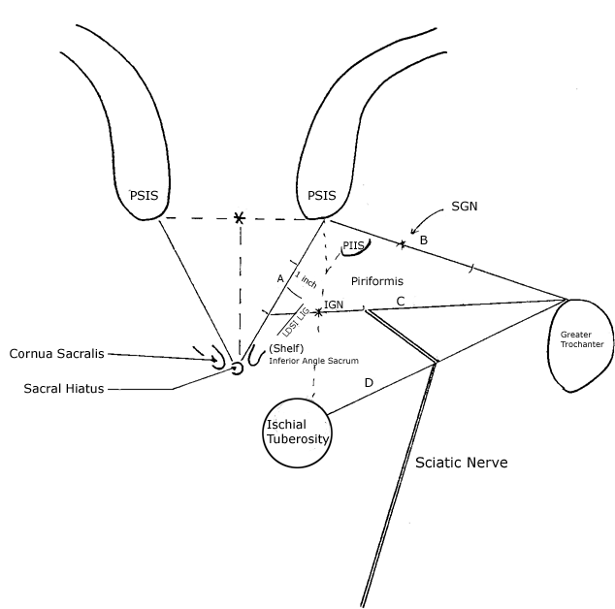
Surface Anatomy

Slide 9
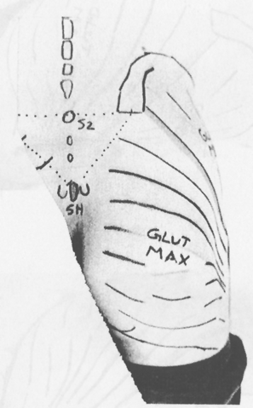
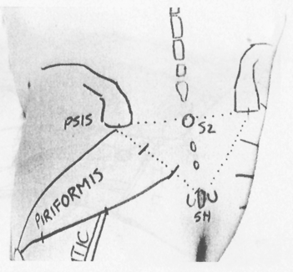
Surface Anatomy

Slide 10
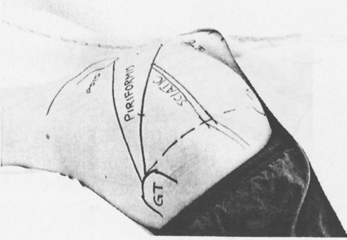
Surface Anatomy

